Slide 1

My Virtual Fridge
Group 17

Slide 2
Project Goals & Objectives:
The purpose of MVF is to pro-actively manage consumers’ food waste while providing them with information to raise awareness.
We are aiming to produce a functioning application that will allow consumers to search for recipes, with specific or left-over ingredients, and have a dashboard consumers can interact to manage their inventory.

Slide 3
Tasks
For the first week, we as a group were researching ideas for the application.
The second week we mainly focused on coming up with a UI that would best suit the application; Also, we’ve done research on what languages/databases would work best for our needs.
The third week is focusing on building the skeleton of our application and getting started on our database.

Slide 4
Deliverables:
Sprint #1: An interactive application with a friendly user UI and a functioning dashboard
Sprint #2: A completed responsive database implemented into the application
Sprint #3: Notification and achievement functions with overall cohesiveness check

Slide 5
Sprint #1:
We aim to launch our website with the basic functionalities integrated:
- Friendly UI Interface
- Registration and Login Page
- Compiled list of Ingredients and Recipes

Slide 6
Sprint #1:
Friendly UI Interface
Our goal is to have a visually appealing website where users can seamlessly navigate the content and interact with their dashboard with minimum amount of effort.
Viewer Friendly and easy to navigate layout
Clickable Ingredients to add to fridge / add to recipe search list.

Slide 7
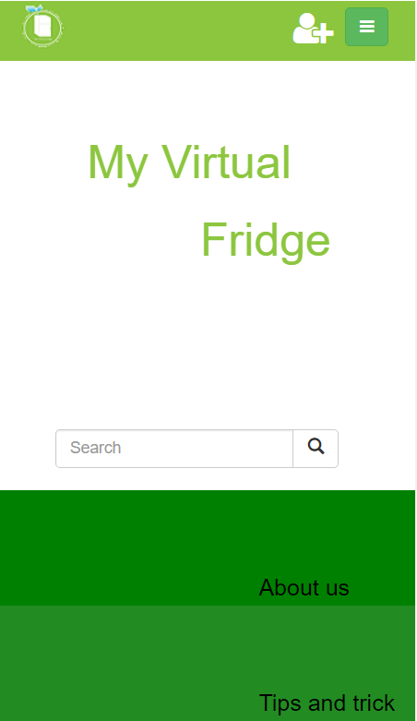

Sprint #1:
Clickable Ingredients
Layout

Slide 8
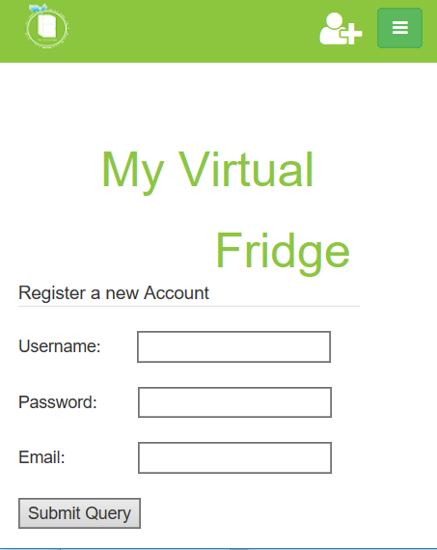
Sprint #1:
Registration and Login Page
- A working registration page
- Ability to Sign in
- Basic Dashboard for each user

Slide 9

Sprint #1:
Compiled list of Ingredients and Recipes
- A list of 40 most used ingredients into our database
- A list of 20 Recipes using the 40 ingredients
- Ability to search for Recipes

Slide 10
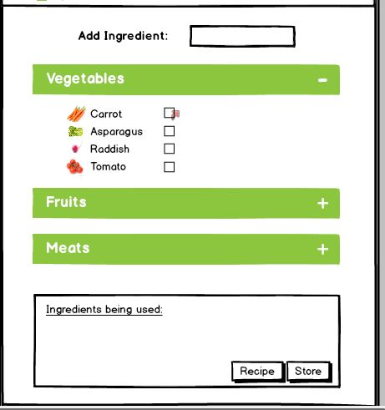
Friday’s Presentation Feedback
The most common feedback we’ve received from the groups is that our font and checkbox, for the layout, is small and we researched a solution.

Slide 11
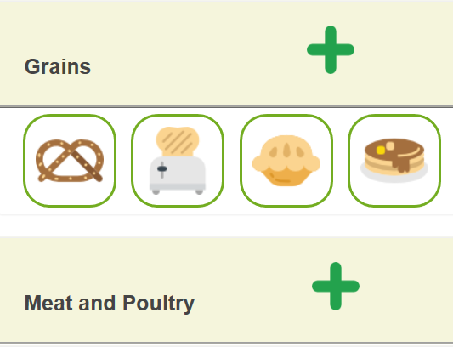
Problem Rectified
We have implemented large clickable icons that users can click and add to their ingredient list.

Slide 12
Affiliated Applications
Application | Group Number | Description
Waste | 23 | An App to track food usage/wastage
Pocket Pantry | 8 | A meal planner & grocery list
WhatsInMyFridge? | 1 | A website that keeps track of when your food expires
EcoList | 10 | Grocery list and meal planner
Meal.io | 29 | App to help families manage the food in their lives

Slide 13
In Conclusion:
We are continuously working on implementing feedbacks while maintaining our focus on bringing an application that users will actively seek out on a regular basis.
We hope to establish a connection with the consumers and help them pro-actively eliminate food waste everyday.
Any questions?

Slide 14
My Virtual Fridge

